Slide 1
Attention in LSTM2LSTM

Slide 2
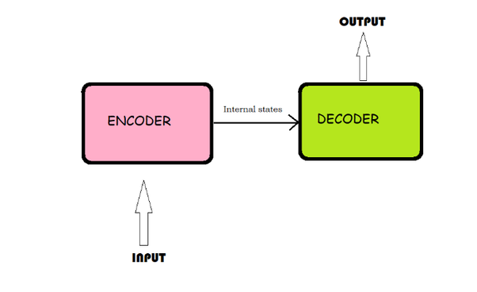
Encoder-decoder architecture
The encoder-decoder recurrent neural network is an architecture where one set of LSTMs learn to encode input into a fixed-length internal representation, and second set of LSTMs read the internal representation and decode it into an output sequence.

Slide 3
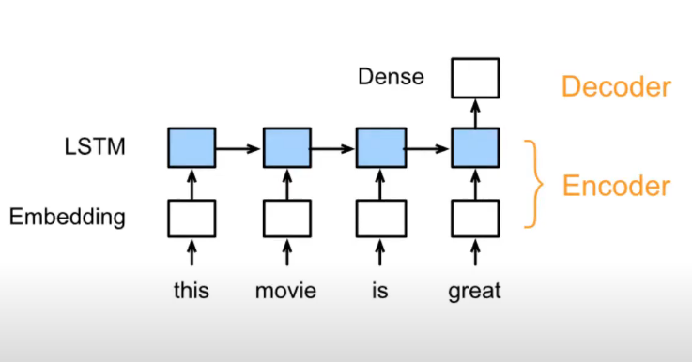
Encoder-decoder architecture
Encoder: present a sequence of text as a vector
Decoder: decode presentation into an output

Slide 4
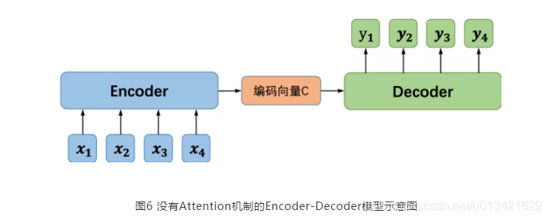
Encoder-decoder architecture
The encoder process inputs
The decoder generate outputs

Slide 5
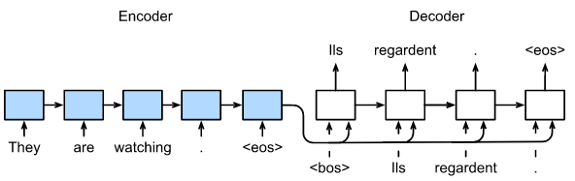
Encoder-decoder architecture
This architecture shows excellent results on difficult sequence prediction problems in some fields such as:
Sequence to Sequence Learning with Neural Networks, 2014
Learning Phrase Representations using RNN Encoder-Decoder for Statistical Machine Translation, 2014
Nevertheless, it suffers from the constraint that all input sequences are forced to be encoded to a fixed length internal vector. This is a problem when dealing with long input sequences because the neural network needs to compress all the necessary information of a source sentence into a fixed-length vector.

Slide 6
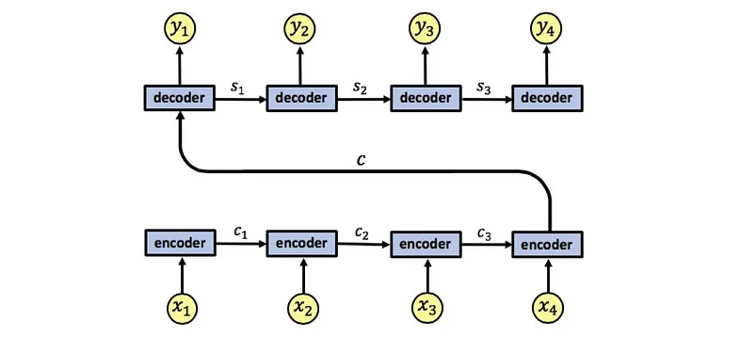
Encoder-decoder architecture
A drawback of this architecture is that the encoder needs to represent the input sequence x1, x2, x3, x4 as a single vector c, which can causes information loss as all information needs to be compressed into c.

Slide 7
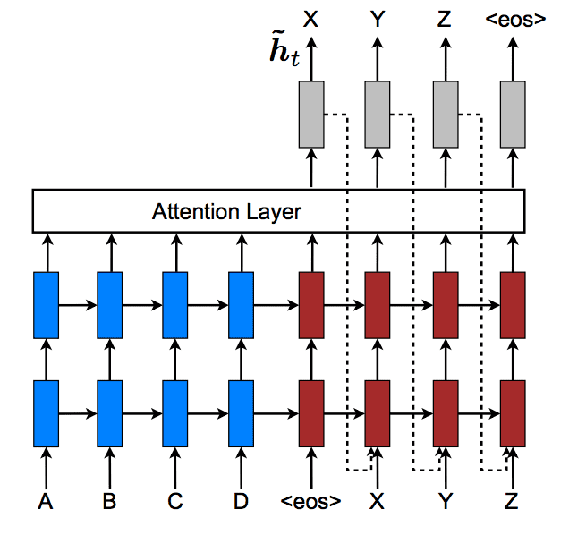
Attention mechanism
The attention mechanism is introduced to tackle this problem. Basically, it looks at all hidden states from the encoder sequence to make predictions. This is achieved by keeping the intermediate outputs from the encoder LSTM from each step of the input sequence and training the model to learn to pay attention to these inputs and relate them to items in the output sequence.

Slide 8
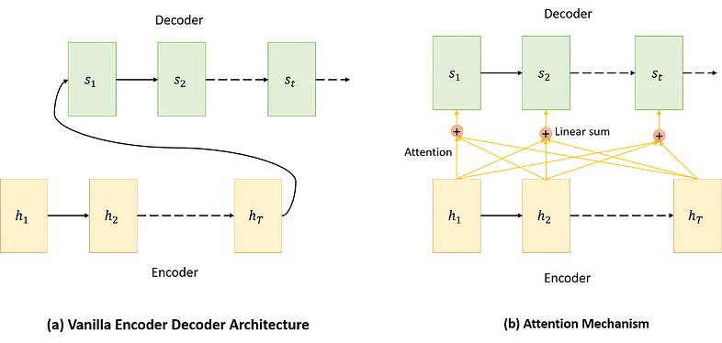
Attention mechanism
Unlike the traditional encoder-decoder architecture that make predictions on the final output of the encoding step, attention-based encoder-decoder architecture attends every hidden state from each encoder node at every time step and then makes predictions after deciding which one is more informative.

Slide 9
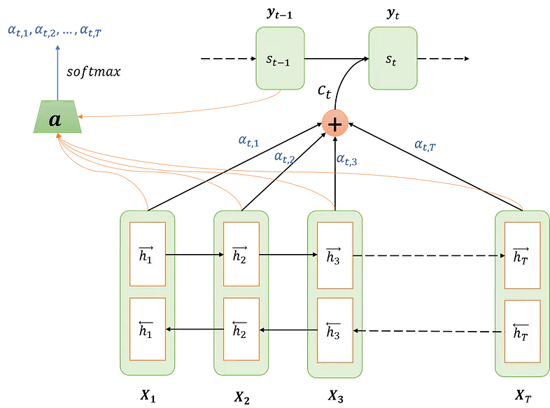
Attention mechanism
All steps in Attention mechanism:
Encoding
Computing Attention weights
Creating context vector
Decoding

Slide 10
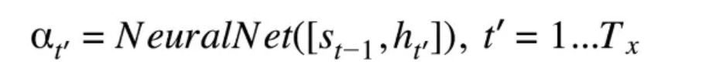
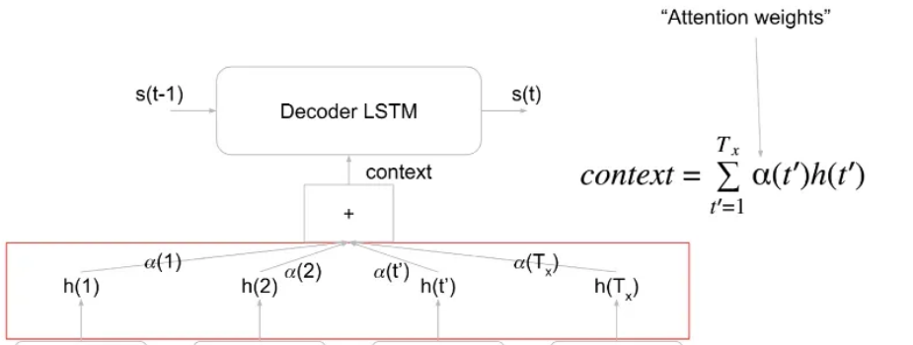
Attention mechanism - Calculate attention weights
Attention weight at every time step t (denoted by αₜⱼ) is the amount of attention to be paid to the hidden state hⱼ and is calculated by the both output of the encoder unit t(hⱼ) and previous decoder output(sₜ-₁):

Slide 11
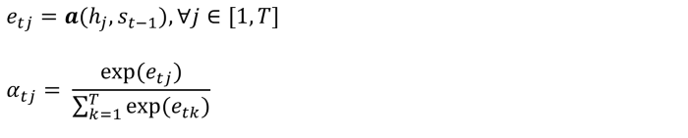
Attention mechanism - Step 1: Calculate attention weights
The Neural Network uses a Softmax unit at the end to normalize the outgoing attention values

Slide 12

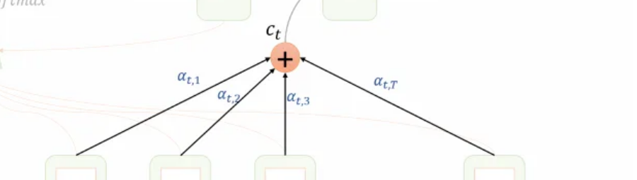
Attention mechanism - Creating context vector
The context vector cₜ is calculated by the linear combination of the hidden values hⱼ and the attention weight αₜⱼ:

Slide 13
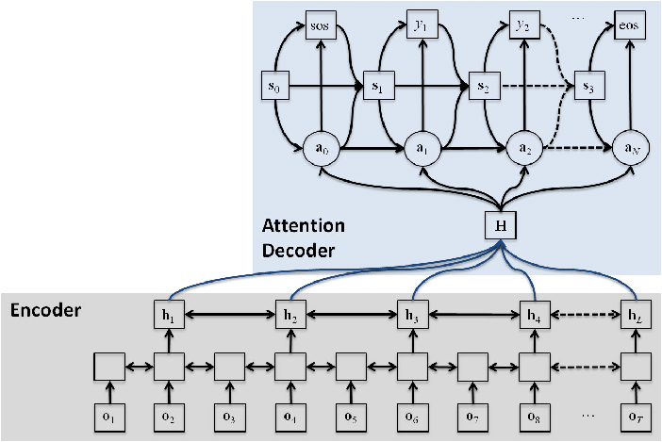
Attention mechanism - Decoding
Finally, cₜ is used along with the hidden decoder output sₜ-₁ to computer the hidden state and output the decoder: sₜ and yₜ.

Slide 14
Attention-based applications
Attention in Text Translation: Attention is used to pay attention to specific words in the input sequence for each word in the output sequence
Attention in Image Descriptions: Attention is used to pay attention to images when outputting a sequence, such as a caption
Attention in Speech Recognition: Attention is used to relate each phoneme in the output sequence to specific frames of audio in the input sequence.
Attention in Text Summarization: Attention is used to relate each word in the output summary to specific words in the input document.

